Slide 1

Cadastral data in the Republic of Slovenia and their renovation
PCC Conference
Metka Malnar,
Darinka Bertole Vienna, 20-21 November 2018
Notes:
Good afternoon to everyone. Let me introduce myself:
My name is Metka Malnar, I work as a senior adviser at The Surveying and Mapping Authority of the Republic of Slovenia (SMA). I have a bachelor‘s degree in surveying and have more than 10 years of experience in dealing with real estate data. I am currently working at the Building Cadastre Sector, which is a pare of the Real Estate Office at the SMA.
The title of my presentation is Cadastral data in the Republic of Slovenia and their renovation.

Slide 2
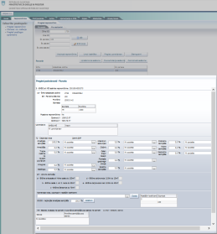
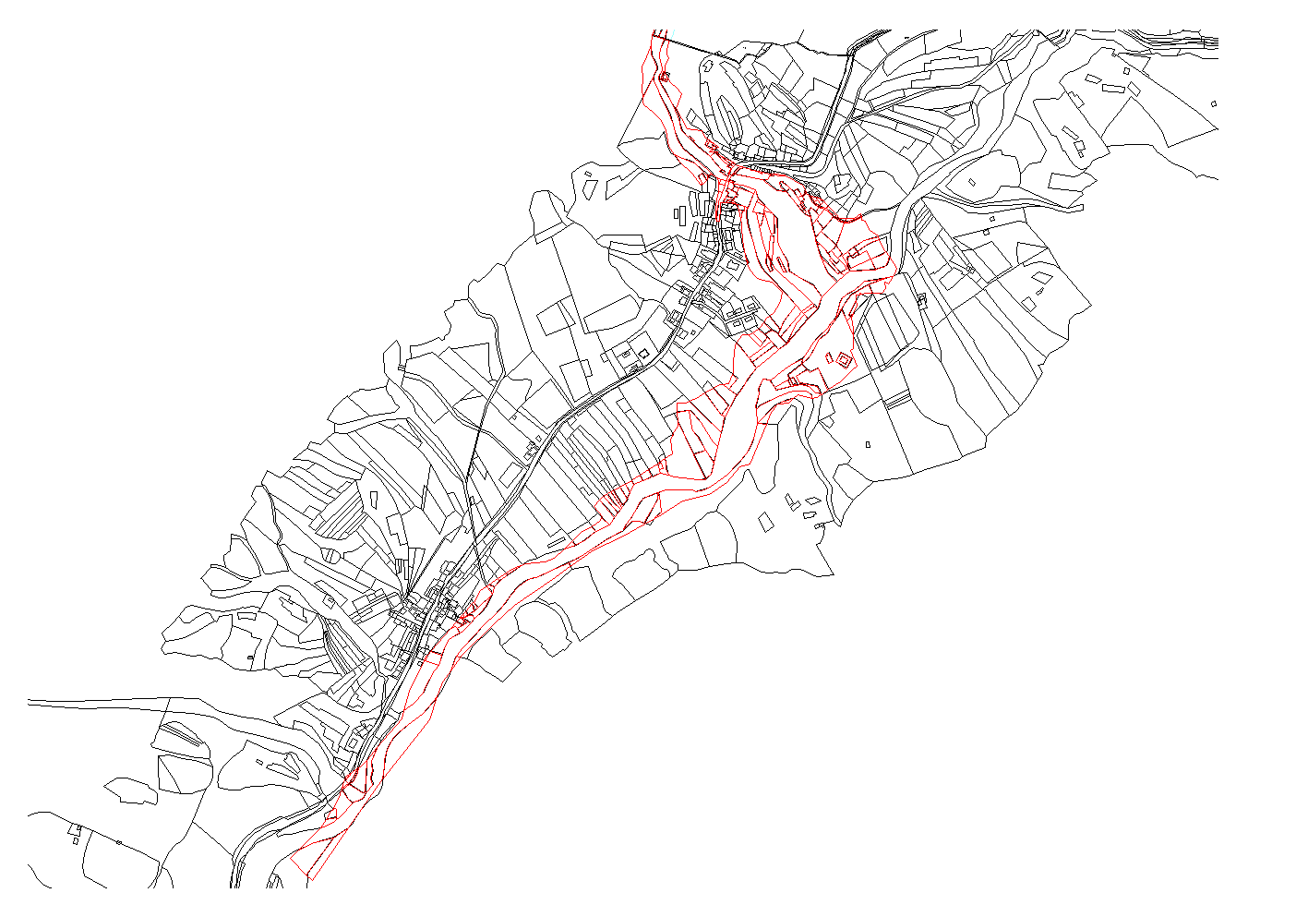
Content:
Cadastral data:
  LAND CADASTRE
  BUILDING CADASTRE
  REAL ESTATE REGISTER
The renovation of cadastral data
Notes:
First we’ll have a look at the cadastral data records we have in Slovenia and later on I will tell about the maintainance and renovation of our cadastral.
We-ll have a look at the land cadaster, the building cadaster and the Real estate register.

Slide 3
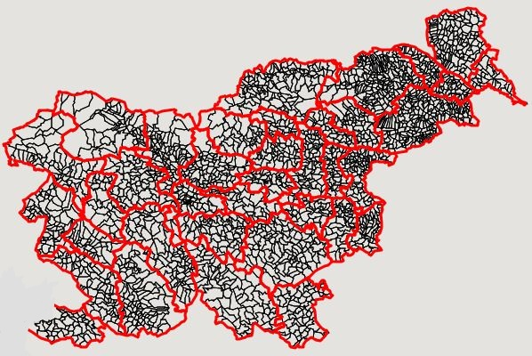
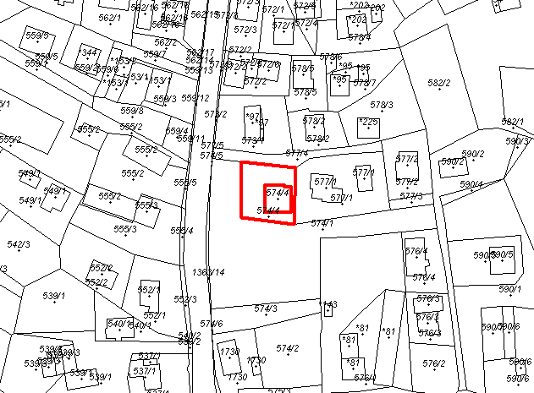
  LAND CADASTER
2698 cadastral areas
5 680 759 parcels
SLOVENIA
ATTRIBUTE DATA
parcel number
boundary
surface area
owner
manager of state or local property
location and shape
actual use
land under a building BUILDING CADASTER
land bonita factor
GRAPHICAL DATA
Land Cadaster Representation
Land Cadaster Map
Notes:
LAND CADASTRE
The Land Cadastre is an official record in which the land is defined in terms of land parcels.
It consists of the latest recorded data of the land and the land cadaster archive.
The basic unit for data management in the Land Cadaster and the Building Cadaster is the cadastral area.
The land cadaster data consist of attribute and graphical data.
Land cadaster graphical data are presented in two ways: Land cadaster representation and Land Cadaster Map.

Slide 4
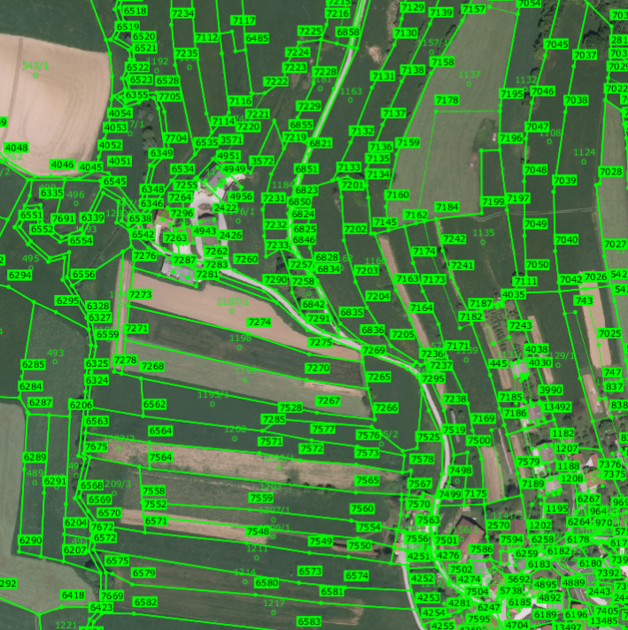
  LAND CADASTER GRAPHICS
Land Cadastre Representation (ZKP)
ZKP - Land Cadastre representation:
a digital image of the shape and positions of parcels
Layer covering all the territory of The Republic of Slovenia
Land cadastre points (ZKT):
32 MIO ZKT with graphical coord.
in the national coordinate system
Notes:
Land cadaster representation – ZKP
Land Cadastre representation is a digital image of the shape and positions of parcels relative to other parcels.
The precision depends on the type of cadastre, the method of survey, the scale of the cadastral map used as the source for the digital cadastral map.
ZKP is created for the entire territory of Slovenia. ZKP is only informative and must not be used for determining the course of the boundary.
The boundaries of parcels are represented by land cadastral points (ZKT). Cadaster points have graphical coordinates in in the national coordinate system. There are more than 32 million cadaster points.

Slide 5
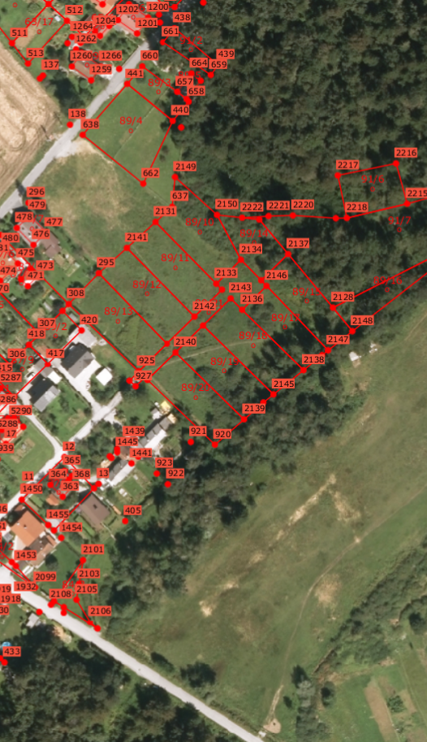
  LAND CADASTER GRAPHICS
Land Cadastre Map (ZKN)
1.074.563 parcels
20 % of all parcels
Only created for individual areas.
Land cadastre points (ZKT):
4.895.284 ZKT (of 32 mio)
numerical coord. determined by field measurments in the national coordinate system
prescribed accuracy within 1m
Notes:
Land cadaster graphics – ZKN
The Land Cadastre map is a graphic representation of the parcel boundaries, which have been recorded using the land cadastre points that have been determined by field measurement and have a prescribed accuracy. These cadaster points have numeric coordinates, determined in the national coordinate system.
The ZKN is not yet designed for the whole country; it is only shown for individual areas.

Slide 6
  BUILDING CADASTER
Established:
2000
RECORDED DATA:
- building number
- owner
- manager of state or local property
- location and shape
- surface area
- actual use
- number of apartment or business premises
ACCURACY:
Graphical accuracy of the floor plan of the building:
Photogrammetry: 0.5 - 1 m
Field measurment: up to 0.3 m
2
3
1
Buildings:
1.184.666
Buildings parts:
1.870.144
Notes:
Building cadaster
The Building Cadastre is a basic record of data on buildings and parts of buildings.
It was established in the year 2000.
There are 1.184.666 recorded buildings and 1.870.144 recorded parts of buildings.
The basic units of the Building Cadastre are a building and a part of a building. Each building has at least one part of the building.
The data that we record in the building cadastre are: number, owner, manager of state or local property, location and shape, surface area, actual use, number of apartment or business premises. The Building cadaster is also connected to Land Cadaster, Land Registry and Register of Spatial units.

Slide 7
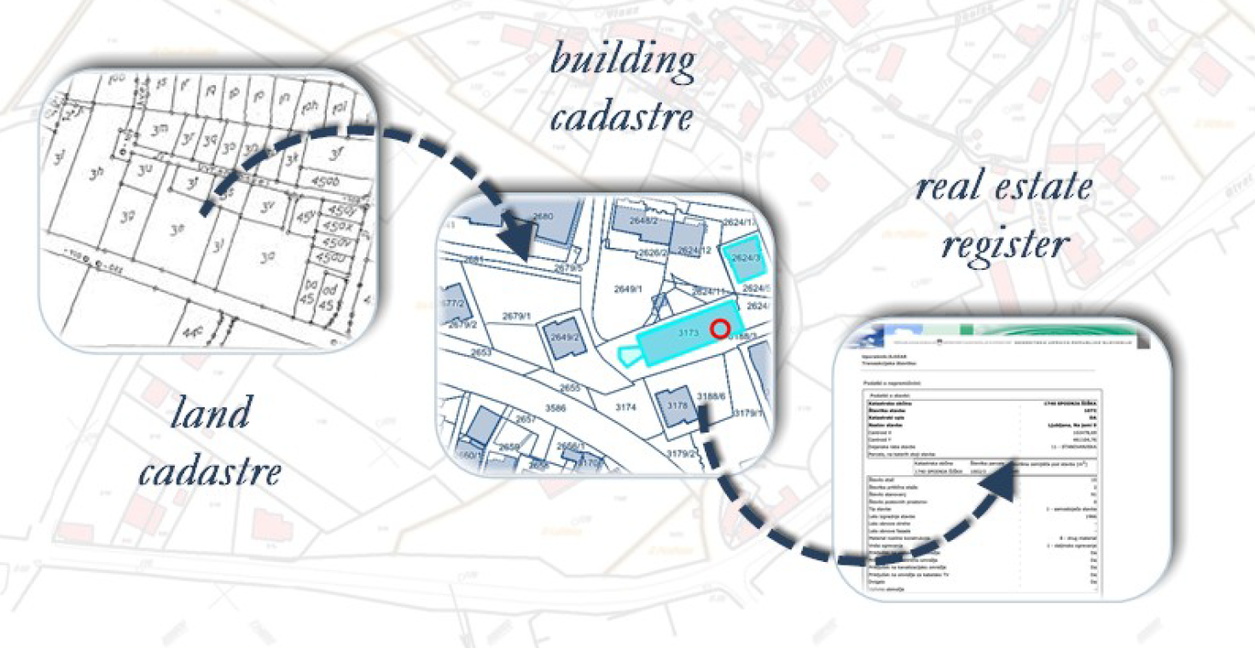
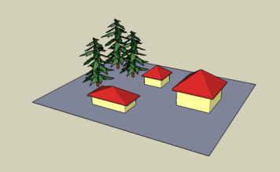
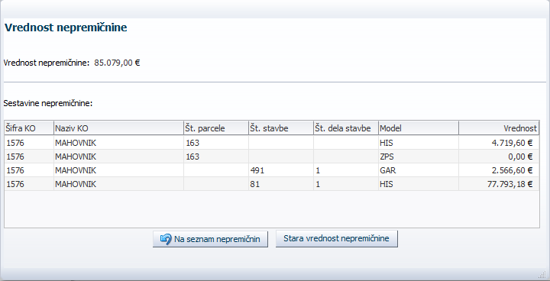
  REAL ESTATE REGISTER
Established:
2008
PARCELS
+ ATTRIBUTE
BUILDINGS DATA
+ ONLY!
PARTS OF BUILDINGS
  VALUE
Notes:
REAL ESTATE REGISTRY
Real Estate Register was established in 2008 for the purpose od mass evaluation of the real estate.
It is a public real estate database, which records real facts about all real estate in one place.
It records the attribute data on parcels, buildings and parts of buildings.
The Register consists of a wide range of data, mostly integrated from other public databases, the main of course are the land cadaster and building cadaster data.
One of the important data is the value of the real estate.
The value of the property is obtained on the basis off mass valuation of real estate.

Slide 8
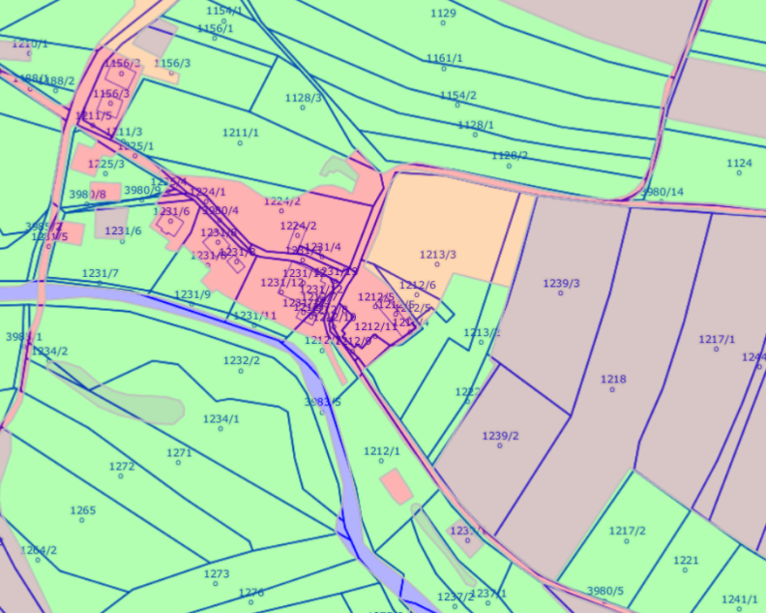
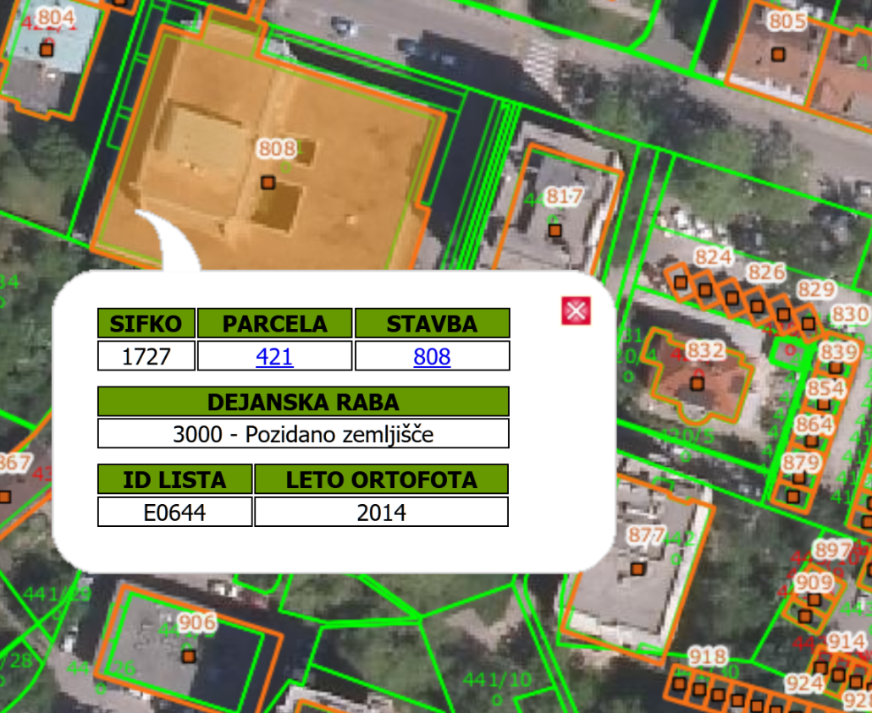
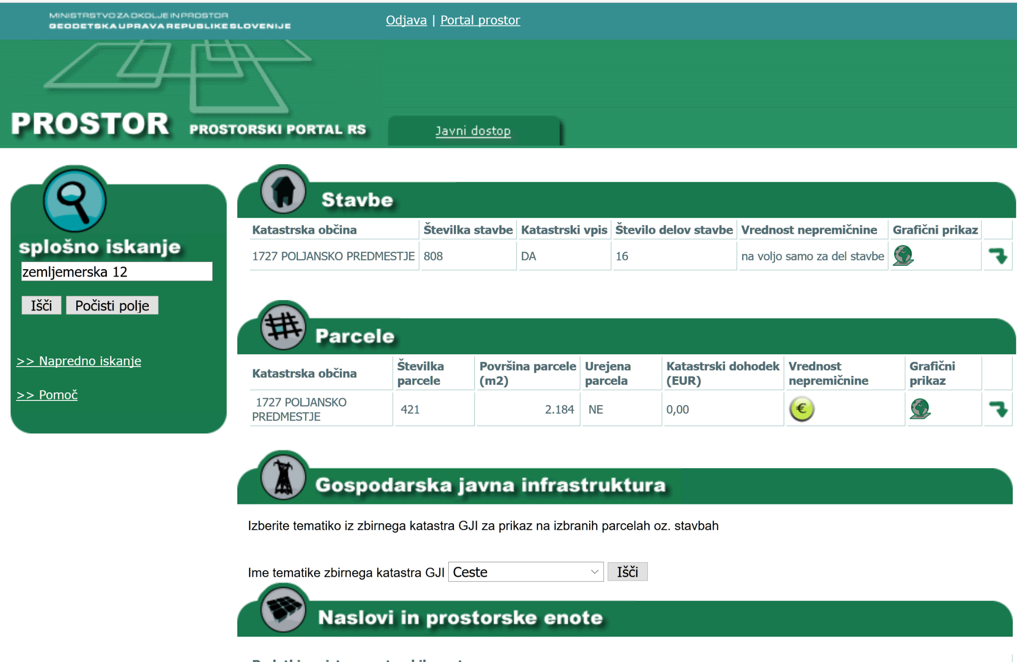
  THE USE OF CADASTRAL DATA:
  owners
  surveying companies
  state and municipal
  administration:
    real estate valuation
    real estate taxation
    land management
    environmental protection
DATA are publicly accesible (excl. owner‘s data) and FREE of charge
  web portal „E-prostor“: http://www.e-prostor.gov.si/
  users can view, order or download data
Notes:
THE USE OF CADASTRAL DATA:
Cadastral data are used by:
land and building owners (for ownership management and other uses)
surveying companies in the provision of the surveying services, when preparing data-processing expert reports.
The data of the land cadastre , building cadastre and real estate register are also used by:
the municipal and state administration bodies as the basis for managing the policy of land management, environmental protection, real estate valuation and taxation. Data are also used by various other users who need real estate data to carry out their tasks or projects.
Land cadastre data (excluding owners' data) are publicly accessible nad are free of charge. The ownership is publicly accessible at the Land Registry, which ia a primary record of real estate property rights in the Republic of Slovenia. Land registry is being managed by Court of Juristiction.
They are visible on the web portal "E-prostor„, where users can view, order or download data.

Slide 9
The renovation of cadastral data
  Regular maintainance procedures
  Cadastral data renovation projects:
  Real estate data improvement
  IT renovation of the real estate system
Notes:
The renovation of cadastral data
The cadastral data at the SMA are being updated and improved through:
-Regular maintainance procedures
- Cadastral data renovation projects
Real estate data improvement
IT renovation of the real estate system

Slide 10
  Regular maintainance procedures
procedures at the request of the owners
regular SMA procedures
SMA is responsible for regular data maintainence and improving the quailty of the data
  Assurance of quality data in the procedures of real estate recording
  Controls are set down for recording a new property and for updating existing property
  Reducing errors in real estate data sets
  Simplifying procedures for recording real estate in cadastres
Notes:
DATA MAINTAINENCE:
Data are updated on a daily bases:
procedures at the request of the owners
SMA is responsible for regular data maintainence and improving the quailty of the data
The management and maintenance of the data from the land cadastre and the building cadastre is carried out in 41 local SMA offices throughout the country.
The land cadastre and building cadaster data are updated with the procedures at the procedures at the request of the owners and with regular SMA procedures.
SMA is responsible for regular data maintainence and improving the quailty of the data, that is achieved by:
Assurance of quality data in the procedures of real estate recording
Reducing errors in real estate data sets
Determening controls for recording a new property and for updating existing property
Simplifyind procedures for recording real estate in cadastres.

Slide 11
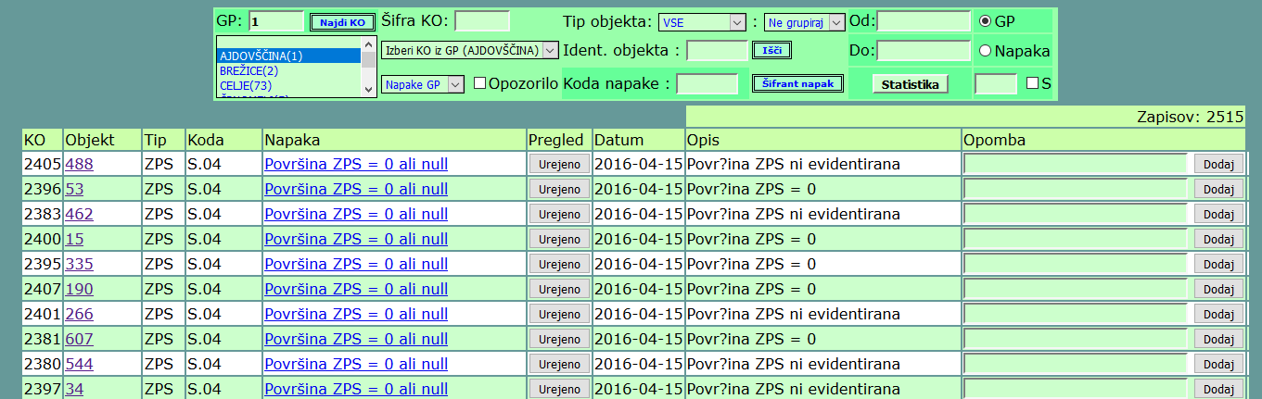
  DATA QUALITY CONTROLS
Atribute controls
Graphical data controls
Topology controls
Notes:
Data quality controls
Atribute controls
Graphic data controls
Topology controls
For the provision of quality data, we periodically (daily and weekly) run data quality control over the database of the land cadastre and the building cadastre.
The control is executed with using a special quality control application.
It runs over the attributes, graphic data, topological correctness of the data and the connection between the land and buildings.
We fix the errors!

Slide 12
ANALYSIS OF DATA AND MEASURES
  DATA ANALYSIS
  -> improving recorded data
Example: ACTUAL USE OF PARTS OF BUILDINGS:
Comparison:
  person has a registered adress in a building (Central population register)
  actual use of a part of that same building
If actual use is not residentail - > field identification
Notes:
DATA ANALYSIS
We use DATA ANALYSIS to improve already recorded data.
Example:
Actual uses of parts of buildings: Comparison between actual use of the part of the building with the fact that a person has a registered address in that building. There is a big probability that this building is residential, so the actual use should be adequate.
Connection of parts of buildings to registered persons (CRPs) - if actual use is not residential - warning - inspection of terrain –
6,864 such parts of buildings

Slide 13
  DATA ACQUISITION
ACQUISITION OF DATA FROM OTHER RECORDS:
information on facade, windows renovation - data taken from Eco Fund
received data: 5506 information of years of facade renovation, 4363 information of years of window renewal (December 2017) – will be repeted in 2019
COOPERATION WITH MUNICIPALITIES
Acquisition - data exchange (Žiri, Semič, Kamnik - partly)
municipal data are the basis for the SMA to demand a change in BC from the owner
Notes:
DATA ACQUISITION
ACQUISITION OF DATA FROM OTHER RECORDS:
information on facade, windows renovation - data taken from Eco Fund
received data: data: 5506 information of years of facade renovation, 4363 information of years of window renewal (December 2017) – will be repeted in 2019
COOPERATION WITH MUNICIPALITIES
Acquisition - data exchange (Žiri, Semič, Kamnik - partly)
municipal data are the basis for the SMA to demand a change in BC from the owner.

Slide 14
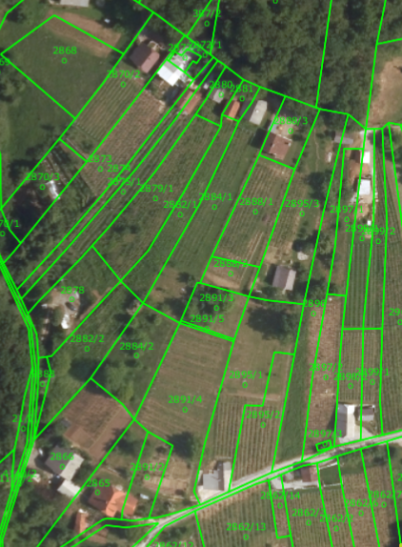
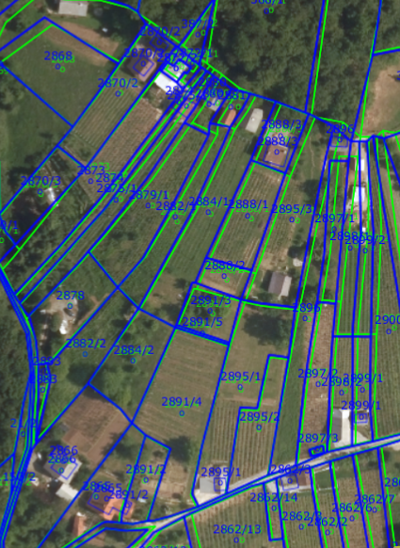
  Project: Location improvement of the Land Cadaster
before
after
20% of cadastral areas improved until now
Notes:
Location Improvement of the land cadastre
Depending on the method of setting up the ZKP and the various procedures for its maintenance in the past.
The ZKP in individual areas does not always reflect the actual situation in nature.
This is most evident when, in the same picture, the ZKP is combined with other spatial data, which show the topographical state in nature (eg digital orthophoto -DOF).
We note that the data is locally incoherent - offset.
The purpose of the location improvement is that ZKTs, which have only graphic coordinates, define coordinates with an accuracy of over 1 m.
Within the framework of the project "Location Improvement of the land cadastre", the Survey and mapping authority implements the location improvement for the territory of Slovenia.
The data processing unit is a cadastral area. At the moment we have improved about 20% of cadastral areas.

Slide 15
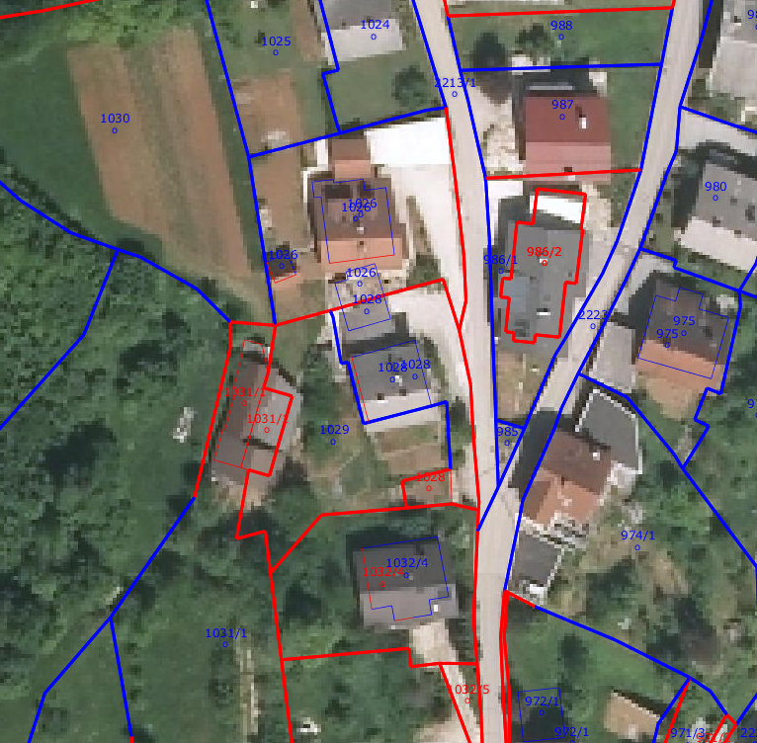
  Project: Location improvement of the Land Cadaster
Improved cadastral points are now included in the ZKN
43 % of all 32 MIO ZKT
ZKT accuracy:
- over 1m
(location improvement)
- within 1m
(field measurment)
Notes:
Improved cadastral points are now included in the ZKN. 43% of all cadastral points have, besides the graphical coordinates,
also the numeric coordinates determined by field measurements or by location improvement process.
ZKT accuracy:
over 1m (blue)
within 1m (red)

Slide 16
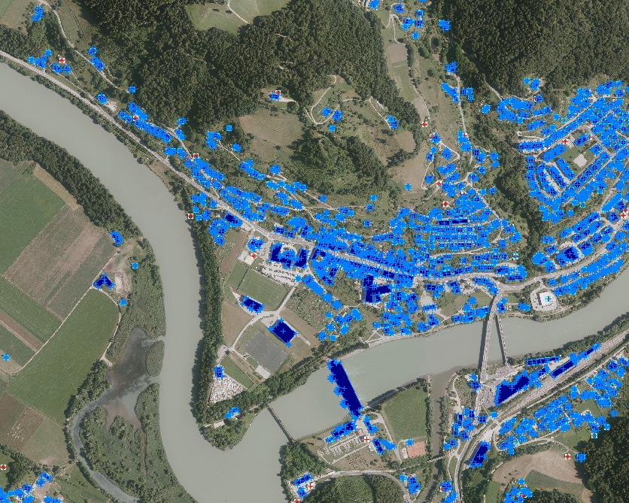
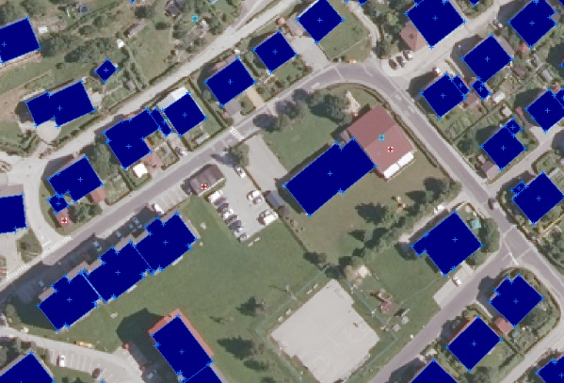
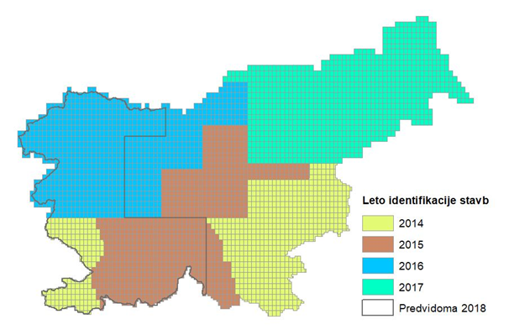
  Project: AUTOMATIC IDENTIFICATION OF BUILDINGS
Comparing existing BC data with other sources (cyclic aerial survey, lidar, other available resources – e.g. topography)
Year 2018:
New buildings: 8.958
Changed buildings: 6.200
Not existing buildings: 4.679
Notes:
AUTOMATIC IDENTIFICATION OF BUILDINGS
AUTOMATIC IDENTIFICATION OF BUILDINGS
automatic identification of buildings:
unrecorded building,
changed buildings,
buildings that are no longer exist- need to be deleted.
Source - cyclic aerial survey, lidar, other available resources (eg topography).
After automatic identification:
Field identification.
The owner is asked to update the BC data changes

Slide 17
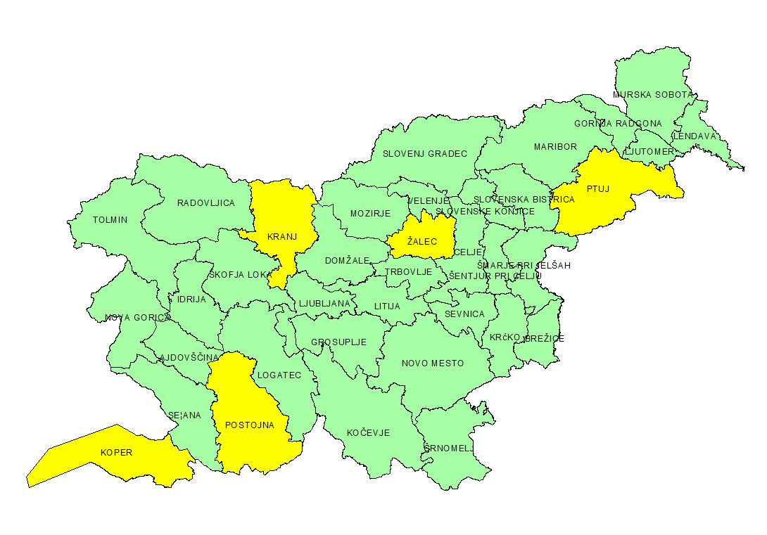
LAND CADASTER (Dec 2018): 1.287.101 expert reports
BUILDING CADASTER (Jan 2019): 207.754 expert reports
  Project: Digitization of the archive
LAND CADASTER
2018, before 2018
easier access
transparency
ease of use
Notes:
Digitization the archive of expert cadastral elaborates
- Land cadaster (2018, before 2018) - 1.287.101
- Building cadaster (est. Jan 2018) – 207.754
Digitizing the archive of expert reports of cadastral measurements:
The entire land and building cadaster archive is been scanned.
The archive (a collection of papers and reports) is stored in digital as well as in physical form.
When the project is finished (by the end of 2018 for LC nad Jan 2019 for the BC), the arhive will consist of:
1.287.101 expert reports (land cadaster)
207.754 expert reports (building cadaster)
Through digitization we achieved easier access to these data, transparency and ease of use

Slide 18
  Reasons:
  - outdated IT solutions
  Purpose:
  - to improve and simplify the real estate records system
  - to achieve the integrity of real estate data
  - better data and process connectivity
  - effective data maintenance
  - better quality of real estate data
  - simple and effective use of real estate data
  GOALS:
  - Single entry point for all users
  - Electronic submission of all expert reports
  - Automatic controls within IT solution
  Project: IT RENOVATION of
  the real estate records system
Notes:
IT RENOVATION of the real estate records system
SMA has been planning this for a long time.
the main reasons for the renovation are outdated IT solutions.
The IT renovation means IT renovation of the Real Estate Records System (Land Cadastre, Building Cadastre, Register of Spatial Units, State Border) and a transition to e-commerce in the field of real estate registration.
The purpose of IT renovation is to simplify the real estate records system – both for the SMA and the field surveying companies, to achieve a more effective data maintenance (less paper -> e-commerce),
all this in an attempt to improve the quality of data and to ensure simple and effective use of data – both real estate and spatial data.
We will introduce a single entry point for all users - in addition to SMA to: surveying companies, municipalities
Electronic submission of all expert reports will be introduced.

Slide 19
  Project: IT RENOVATION of
  the real estate records system
  by the
  end of 2021!
LAND REGISTRY
MKGP – actual land use
MNZ - CRP
REAL ESTATE
CADASTER
MOP – GP, UA, dedicated use
AJPES - PRS
Local communities
State administration offices
Forest service
  Connection with other information systems
  E-commerce for all users
  Optimization and uniform way of data maintenance and procedures management
Notes:
IT RENOVATION of the real estate records system
Our ultimate goal is to establish a central real estate data record – REAL ESTATE CADASTER that wil replace current real estate records.
- This IT solution will be closely linked to other data sets
E-commerce will be introduced to all users.
With enhanced e-commerce, we follow the goal of a unified way of maintaining and managing data.

Slide 20
E-mail: metka.malnar@gov.si
THE SURVEYING AND MAPPING AUTHORITY OF THE REPUBLIC OF SLOVENIA
Zemljemerska ulica 12, 1000 Ljubljana e-mail: pisarna.gu@gov.si
Thank you!

